Slide 1
Challenge 8
Team members:
Shisheng wang
xiangtian yi
Ye xing
Yanlin zhou

Slide 2
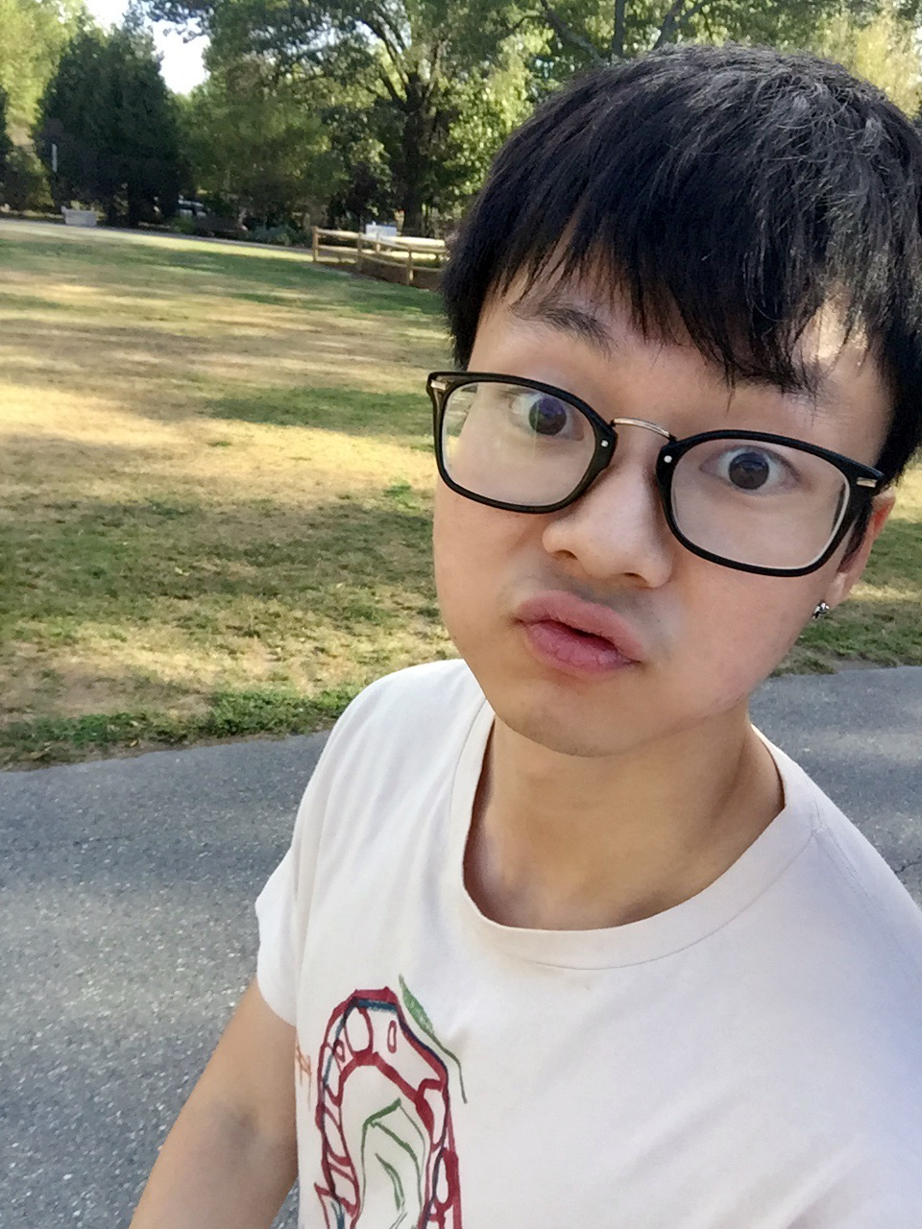
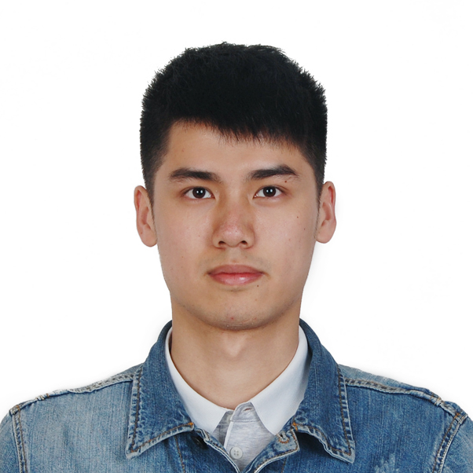
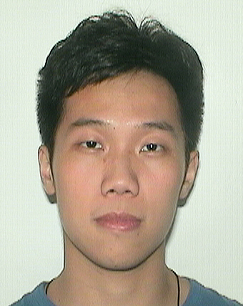
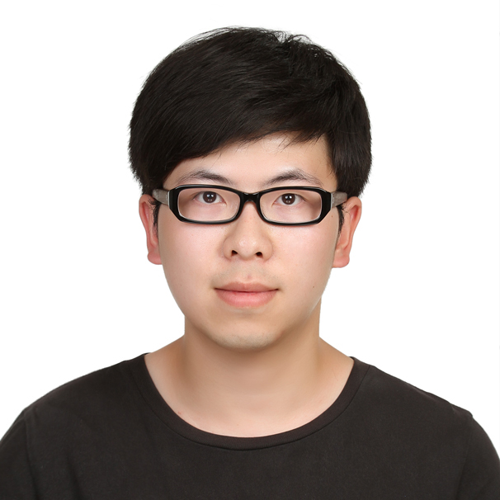
Presenter on this challenge
 | Xiangtian | Shisheng | Ye | Yanlin
Challenge 1 | Presenter
Challenge 2 |  | Presenter
Challenge 3 |  |  | Presenter
Challenge 4 |  |  |  | Presenter
Challenge 5 |  |  | Presenter
Challenge 6 |  | Presenter
Challenge 7 |  |  |  | Presenter
Challenge 8 | Presenter

Slide 3
TEAM WORK
Xiangtian | Shisheng | Ye | Yanlin
I set up the camera, fixed the patch bug within it. Helped designing the UI. Besides, I implemented the first part of the node.js file for remotely controlling the car. | I set up 4 beacons and recorded the localization data,I tested lots of data to make it accurate to show the location on the webpage. | I mainly designed the code of arduino for auto and manual driving. Testing the car with Yanlin and implemented the localization code. | Designed the UI and programmed the webpage. Integrated the car. Optimized the PID control and designed the passing-gap algorithm with Ye Xing. Testing the car.

Slide 4
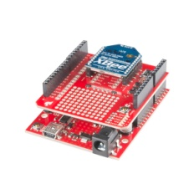
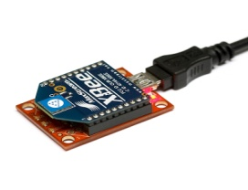
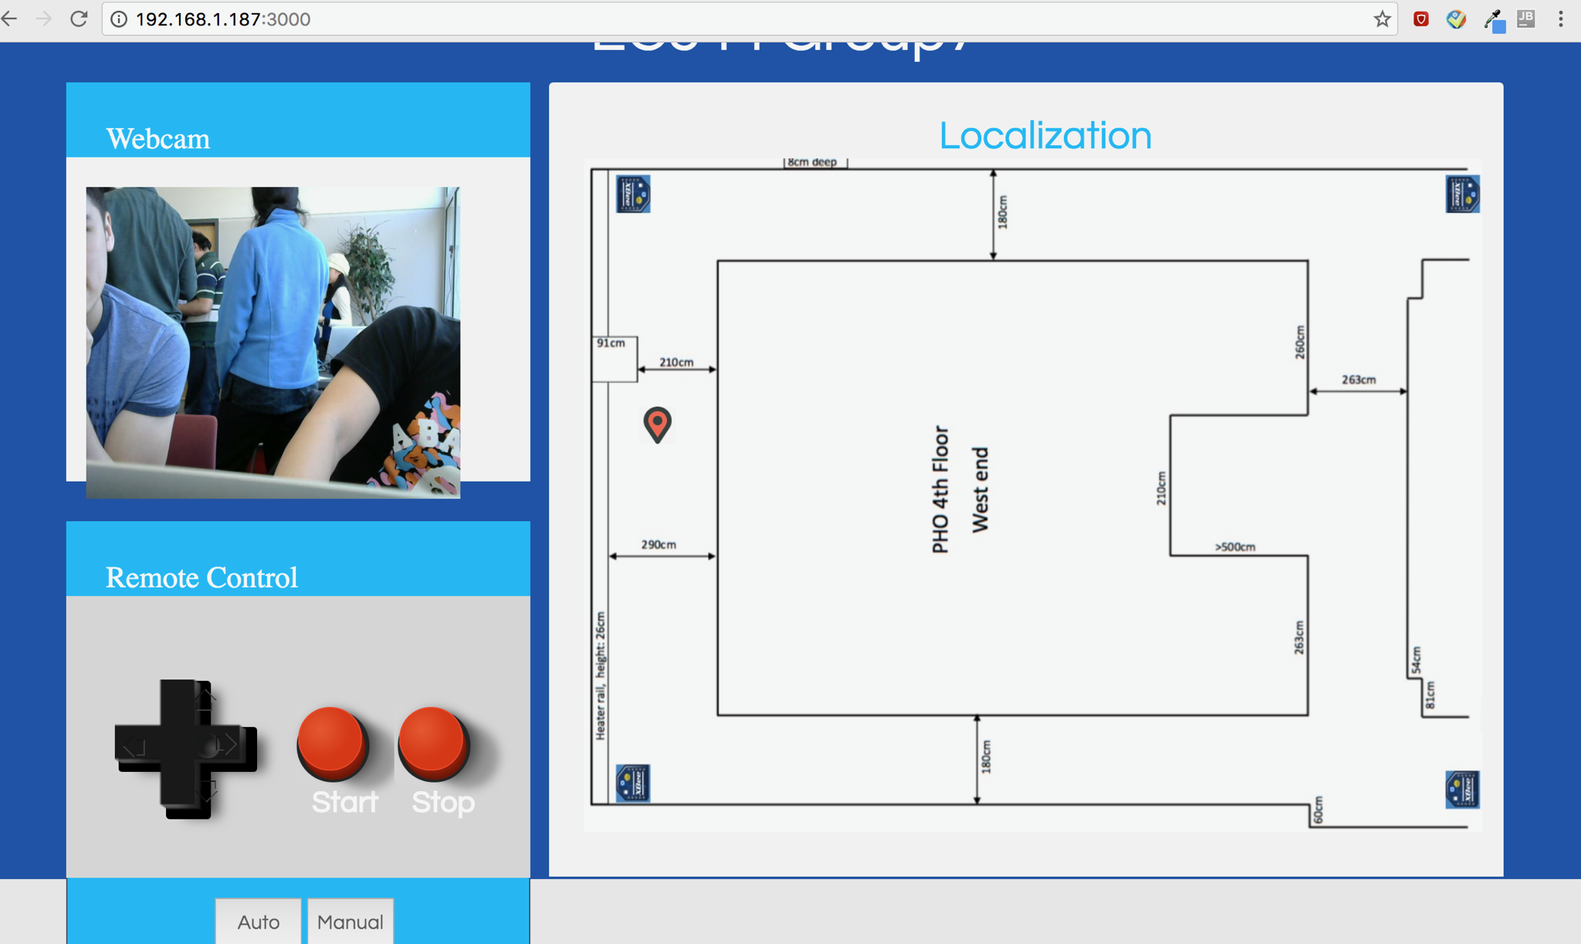
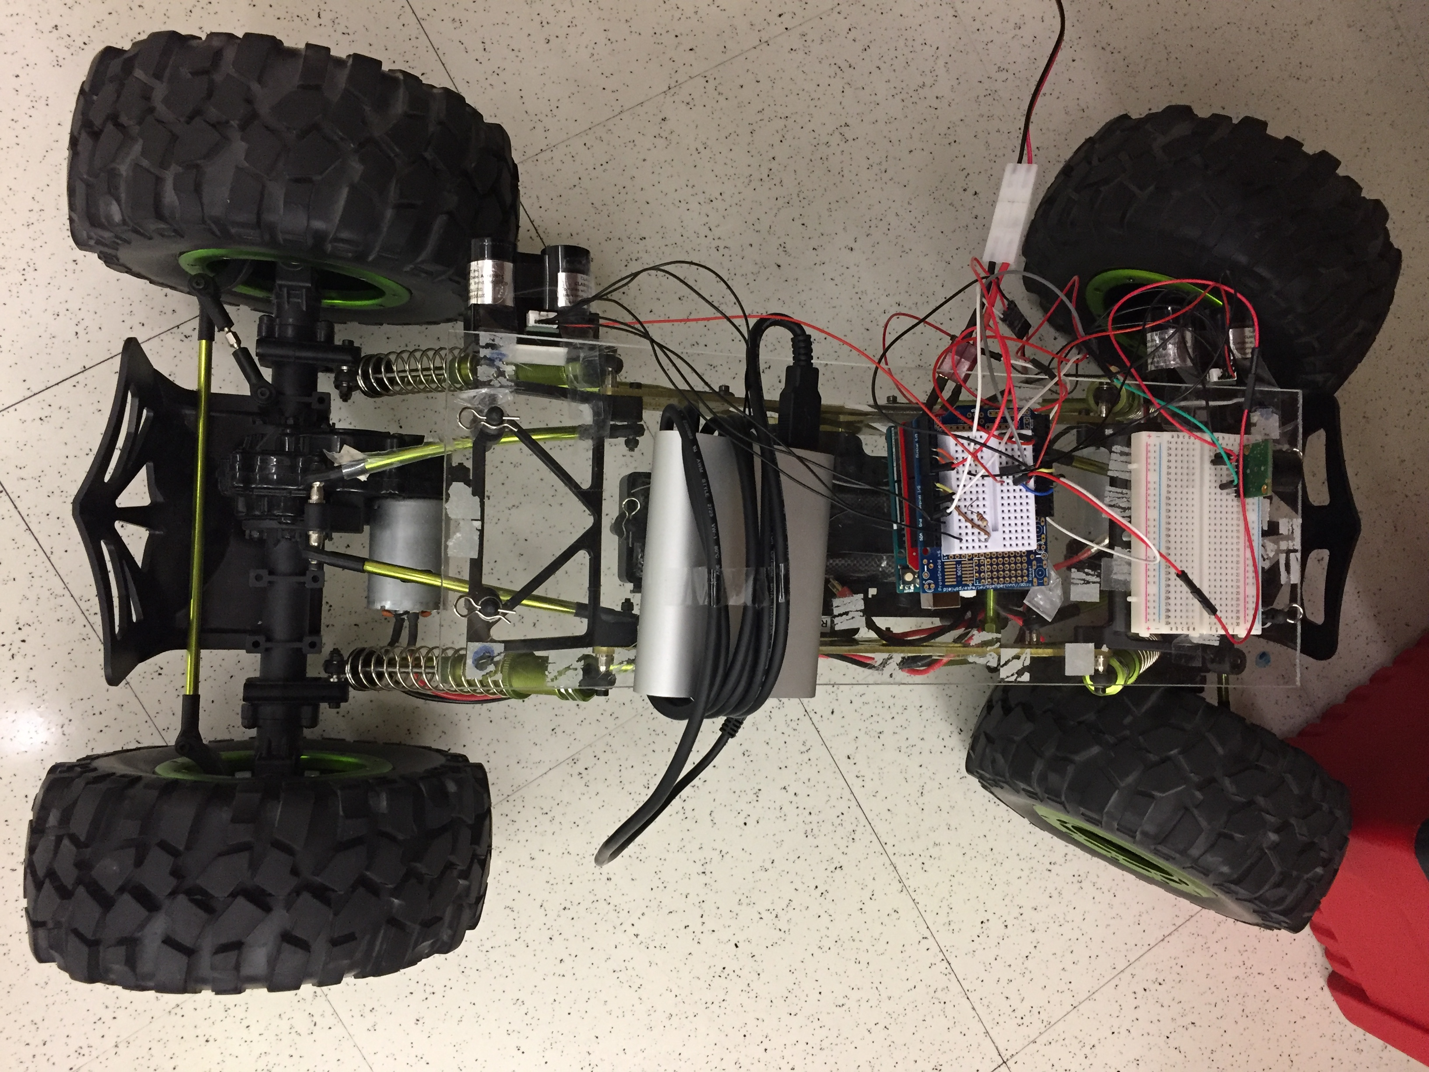
architecture
Coordinator
RSSI
RSSI
Beacon 1
Beacon 3
RSSI
RSSI
Node.js
Beacon 2
Beacon 4
Coordinator
router

Slide 5
Photos of developed system

Slide 6
DESIGN DECISIONS
Sensors
2 LIDAR sensor on both sides
Using the smaller value to control the car
Accurate measures
1 Ultrasonic sensor in the front
Effectively detecting things ahead
scalable

Slide 7
DESIGN DECISION
Algorithm choose
Compared with other methods, KNN is a better solution for Xbee
Implement it on Raspberry Pi
Use Node.js KNN library to train the dataset and define the location
Front end
Design a map on webpage and use a point to show the location
Jumpy data correction
Use queue to store data and take the average to predict
Record the previous location data and we set a bound to limit the difference between previous and current lower than 1 step.

Slide 8
DESIGN DECISIONS
Control Algorithms
Side
PID: Distance to both sides of wall
Adapt the output to adjust the wheel direction
Bound control
Front
Read data from the ultrasonic sensor and stop if obstacle ahead
Remote Control
Use Xbee to remote start and stop the car

Slide 9
Challenge & future improvement
Challenges:
Test the PID control and Re-adjust the most suitable parameter
The localization is not accurate because of the weak wifi signal
Test multiple ways to pass the elevator hall
Manual control latency because of the weak signal
Patch setting of the camera
Improvement:
Turning accuracy
Localization accuracy
Turning speed
Manual control speed

Slide 10
Thank you !

